Slide 1

Project csd301
Dynamic programming in Part of speech tagging for sentiment analysis

Slide 2
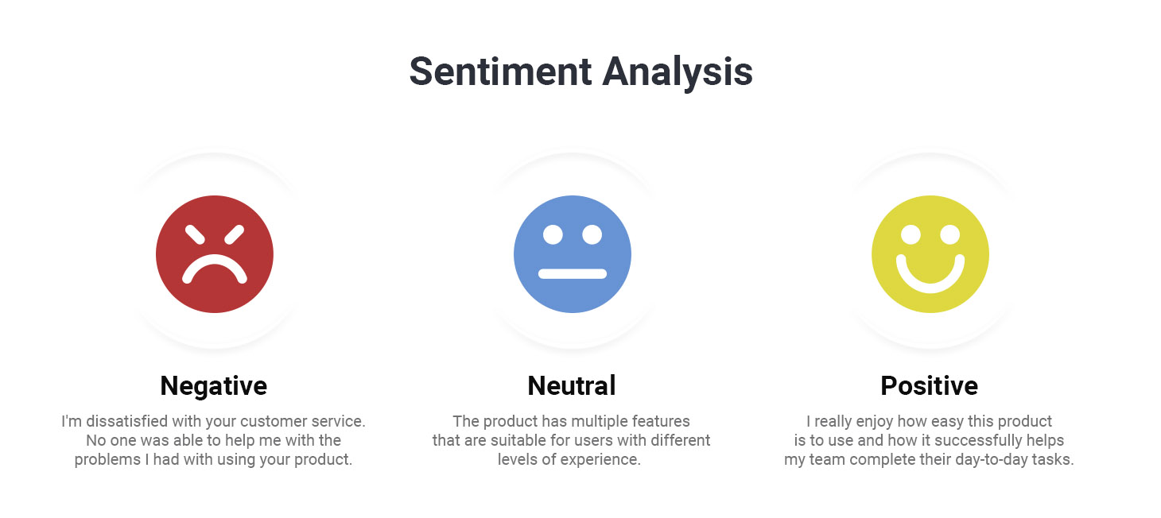
Problem: Sentiment Anaslysis
+Sentiment Analysis: is a nlp technique to classify the data is whether positive, neutral, negative
+often used in businesses monitor brand product sentiment in customer feedback.
+used in classifying tweets, comments in social media.

Slide 3
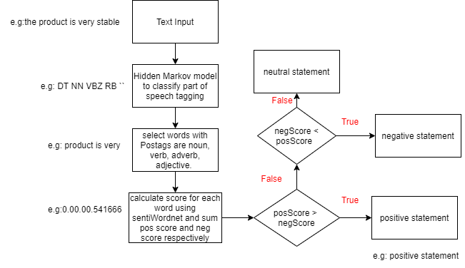
Overall program

Slide 4
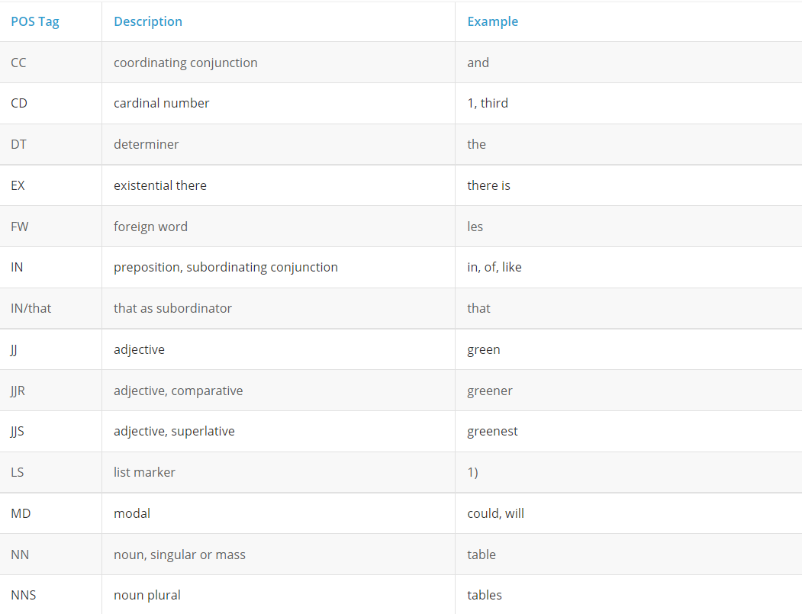
Problem: Part of speech tagging
+ Given a sentence, tagging each tokens in sentence based on the grammar, part of speech, sometimes with tense and number(plural, singular) with a correct tag.
+There are 46 tags in the Penn treebank dataset : IN, : , RP , JJS , JJR, etc.
+ Example: Pennzoil rumored to be accumulating a stake in Chevron in order to push for a revamping of the company.
NNP VBZ VBN TO VB VBG DT NN IN NNP IN NN
TO VB IN DT NN IN DT NN

Slide 5
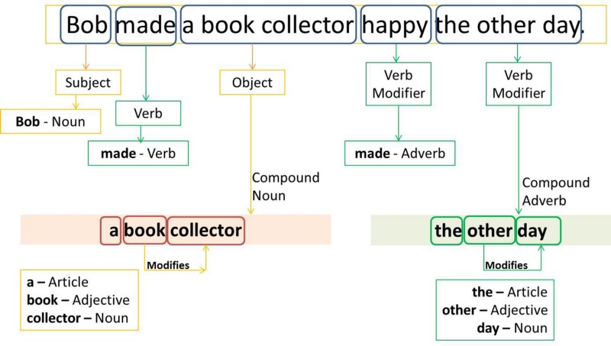
POS applications
+Text to speech conversion
+Providing search engine result for SMS question
+Transforming website content in different language
+Automated grammar error detection
+Dictionary word prediction

Slide 6
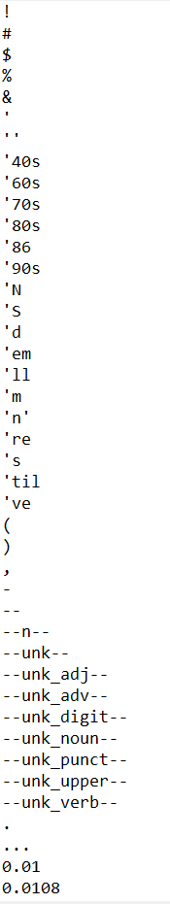
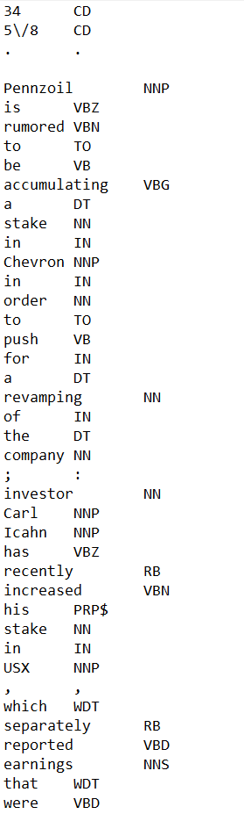
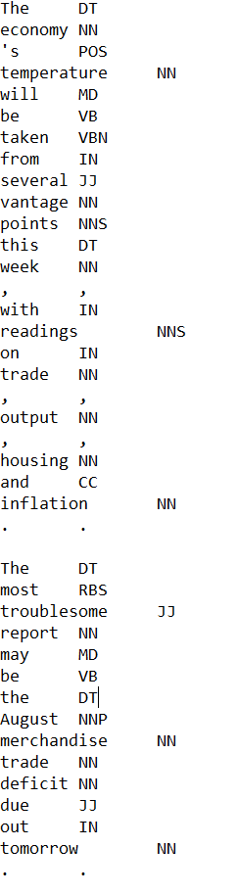
Dataset
+There are 4 files:
  1 file vocab,
  1 file for training dataset,
  2 file for test dataset.

Slide 7
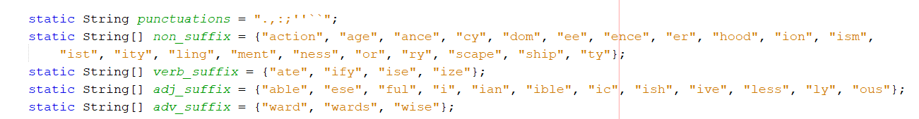
Preprocess Data
+Read files train dataset into a list named train corpus .
+Create vocab of words where keys are unique ids for each word and value is the word itself.
+Read file test dataset. For the word that is not in vocab, determine what type of that word and assign the “—unk_type--” tag for that word. Ex: vantage has an “age” suffix which is a noun suffix, so assign “—unk_noun--” tag.

Slide 8
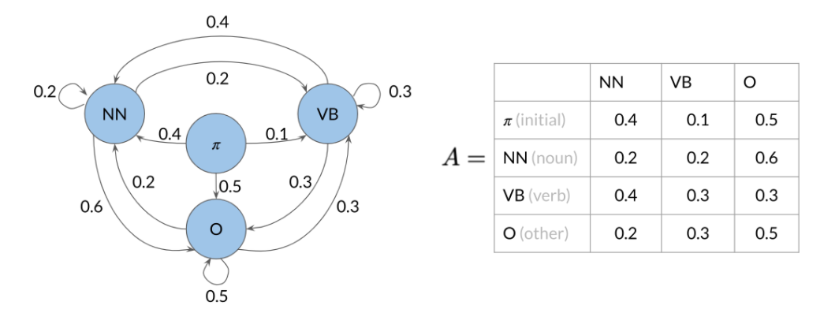
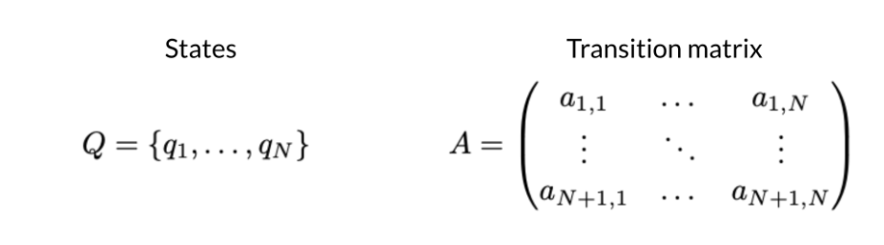
Markov chain for POS tagging
+Transition matrix: all probabilities given by all possible states can be reached from a current state.
+The first state to transition is the initial state,
+The size of transition matrix is (N+1)xN
with N is number of possible states except the initial state.

Slide 9
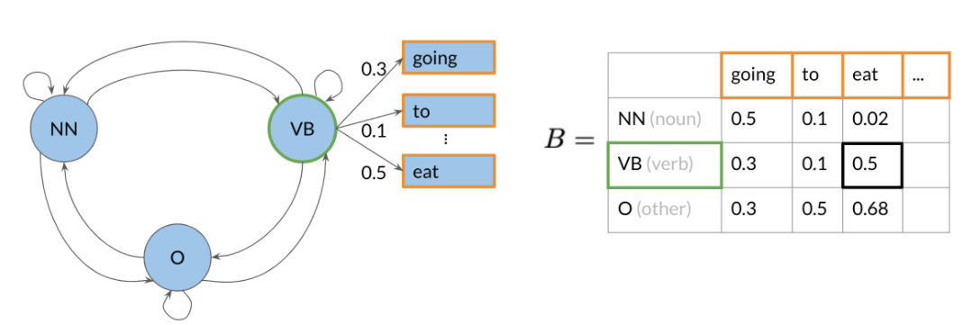
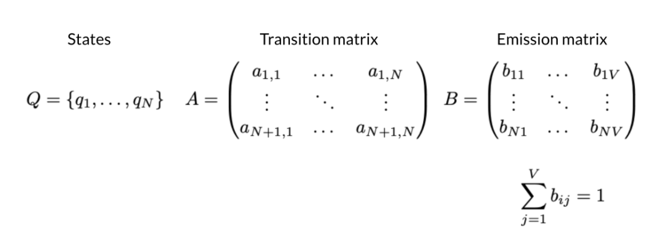
Hidden Markov model
+Emission matrix: The probabilities of given a Pos tag, what is the most possible word for that Pos tag.
+The size of emission matrix is NxV with N is the number of tags and V is the number of words in vocab.

Slide 10
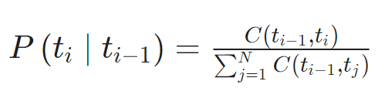
Calculating probabilities
+ function C is count function that count number occurrences of every pair of tags
+ The probabilities P is the probabilities of how much likely is the tag t_i given the tag t_(i-1).

Slide 11
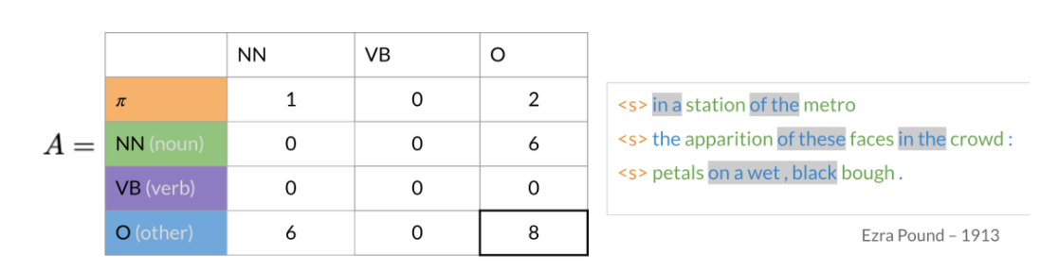
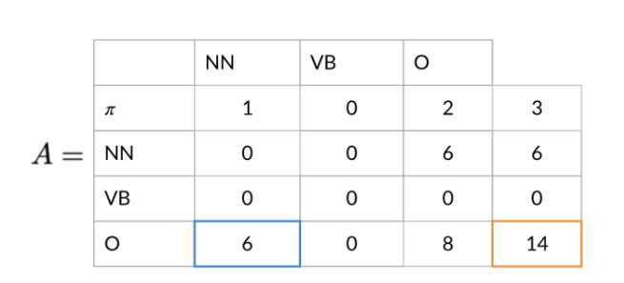
Populating transition matrix
+Keep track number of times each tag show up before another tag.

Slide 12
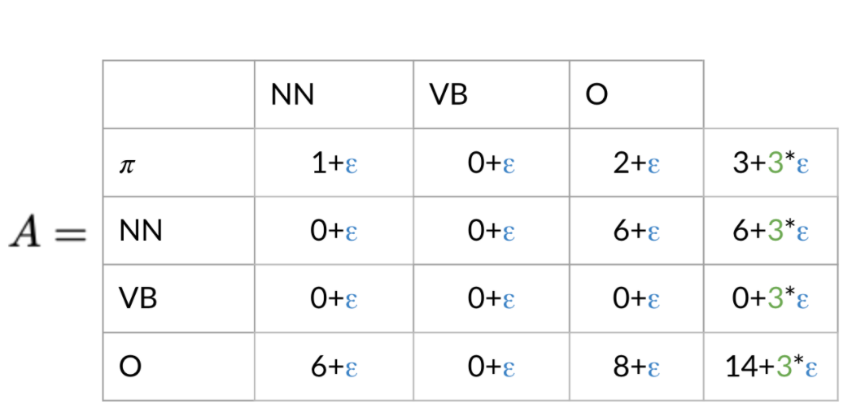
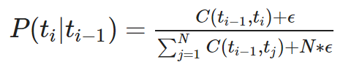
Populating transition matrix

Slide 13
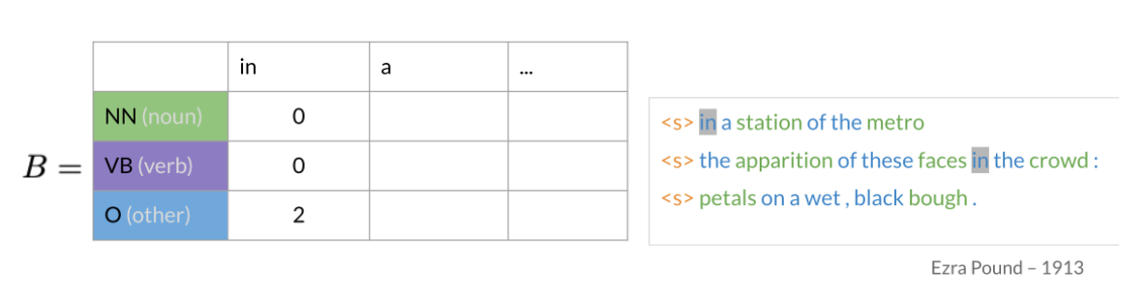
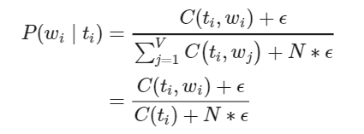
Populating emission matrix
+Keep track of the words associated with their part of speech tags.

Slide 14
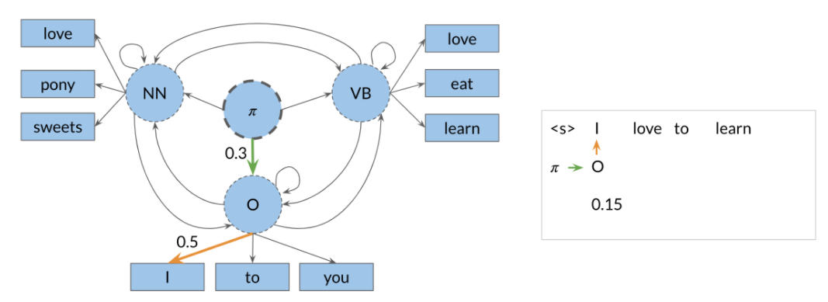
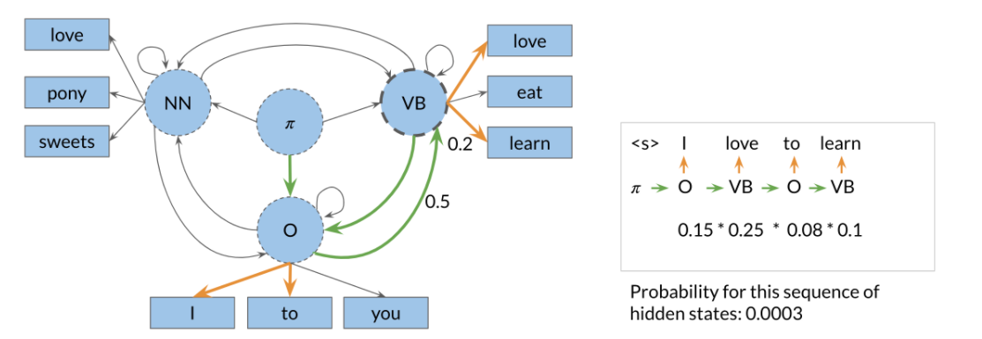
Viterbi decoder(DP programming)
+Pick the sequence with highest probability

Slide 15
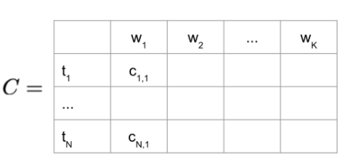
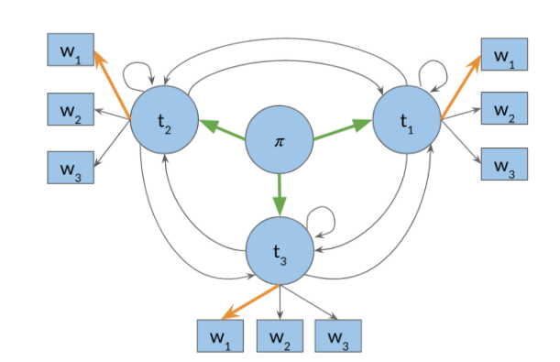

Populating first column of C
Matrix C tells what part of speech each word belongs to

Slide 16
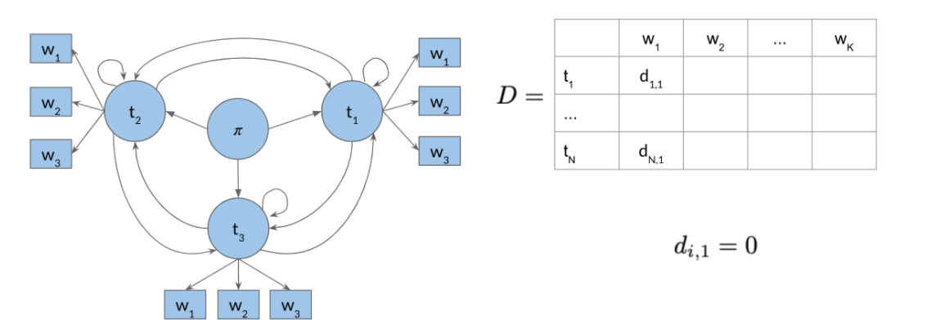
Populating first column of D
Matrix D allows store label path

Slide 17
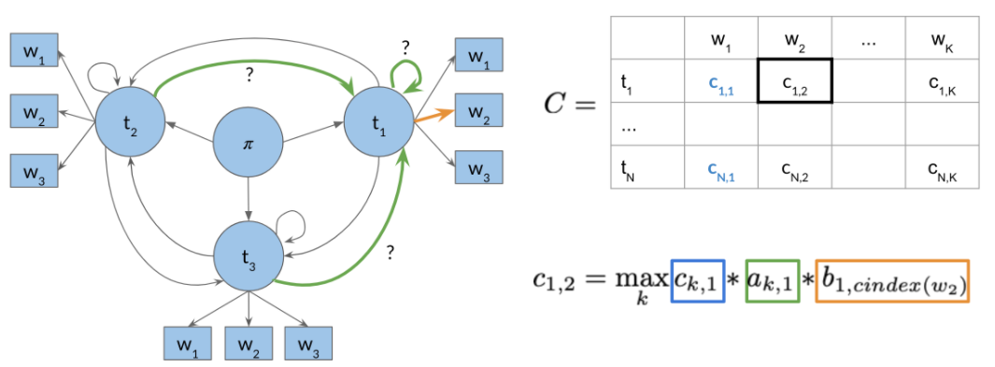

Viterbi forward

Slide 18
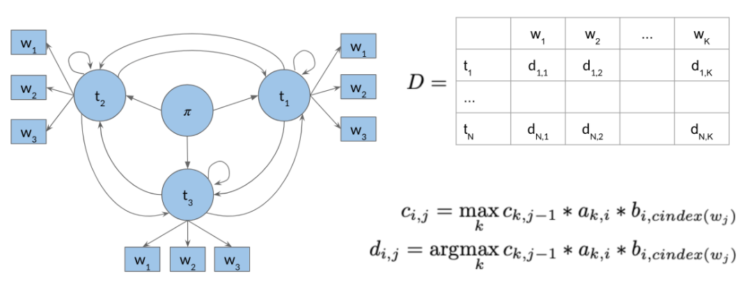
Viterbi forward

Slide 19
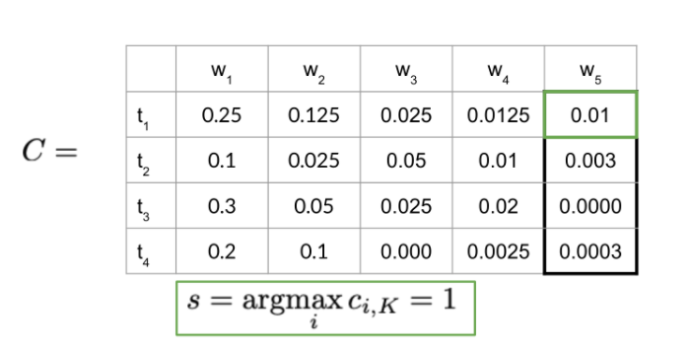
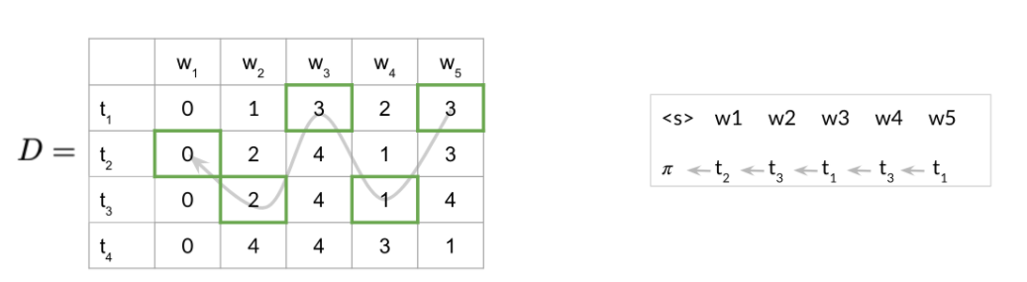
Viterbi backward pass

Slide 20
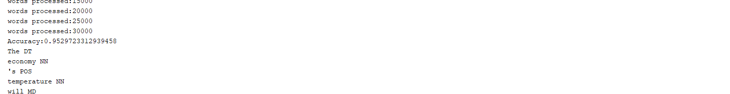
Evaluate Postagger on test data

Slide 21
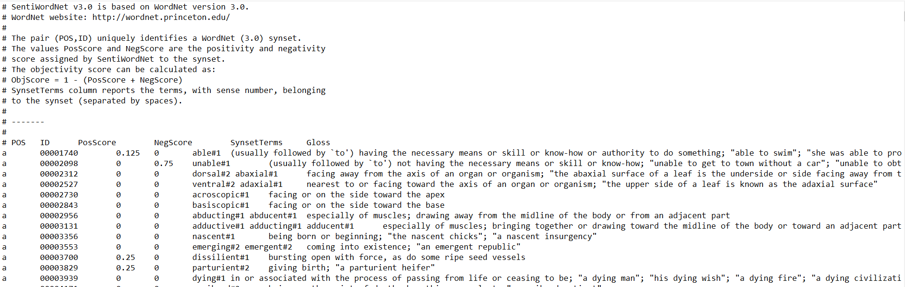
SentiWordnet3.0
+ Is a lexical resources supporting sentiment classification and opinion mining application.
+is the result from automatically annotating Wordnet synsets according to their degree positivity, neutrality, negativity.

Slide 22
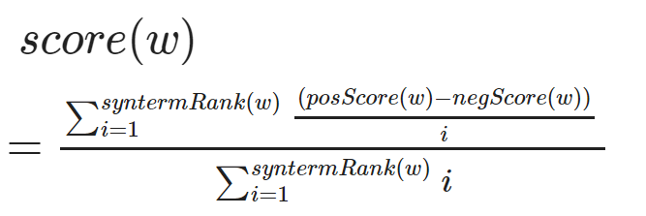
Calculate score of a word
Score(w): is the score of the word input
syntermRank(w): is sense number of the word in sentiWordnet
posScore(w) positive value of the word
negScore(w): negative value of the word

Slide 23
The end

